Slide 1
Assignment-Discussion POS Tagging Using HMM
200050020,4th year, CSE
200050023,4th year, CSE
200050075,4th year, CSE

Slide 2
Problem Statement
Given a sequence of words, produce the POS tag sequence
Technique to be used: HMM-Viterbi
Use Universal Tag Set (12 in number)
5-fold cross validation
“ADP”, “PRT”, “ADV” , ”CONJ”, ”NUM”, ”X”, “.”, ”VERB”, ”ADJ”, ”PRON”, ”DET”, ”NOUN”

Slide 3
Overall performance
Precision : 0.9247
Recall : 0.9231
F-score (3 values)
F1-score : 0.9222
F0.5-score : 0.9231
F2-score : 0.9224

Slide 4
Per POS performance
Tag Precision Recall F1-score
ADP 0.903 0.970 0.935
PRT 0.913 0.841 0.876
ADV 0.901 0.857 0.879
CONJ 0.985 0.991 0.988
NUM 0.982 0.781 0.868
X 0.800 0.113 0.196
“.” 0.948 0.999 0.973
VERB 0.965 0.900 0.932
ADJ 0.853 0.851 0.852
PRON 0.857 0.953 0.902
DET 0.901 0.959 0.927
NOUN 0.923 0.907 0.914

Slide 5
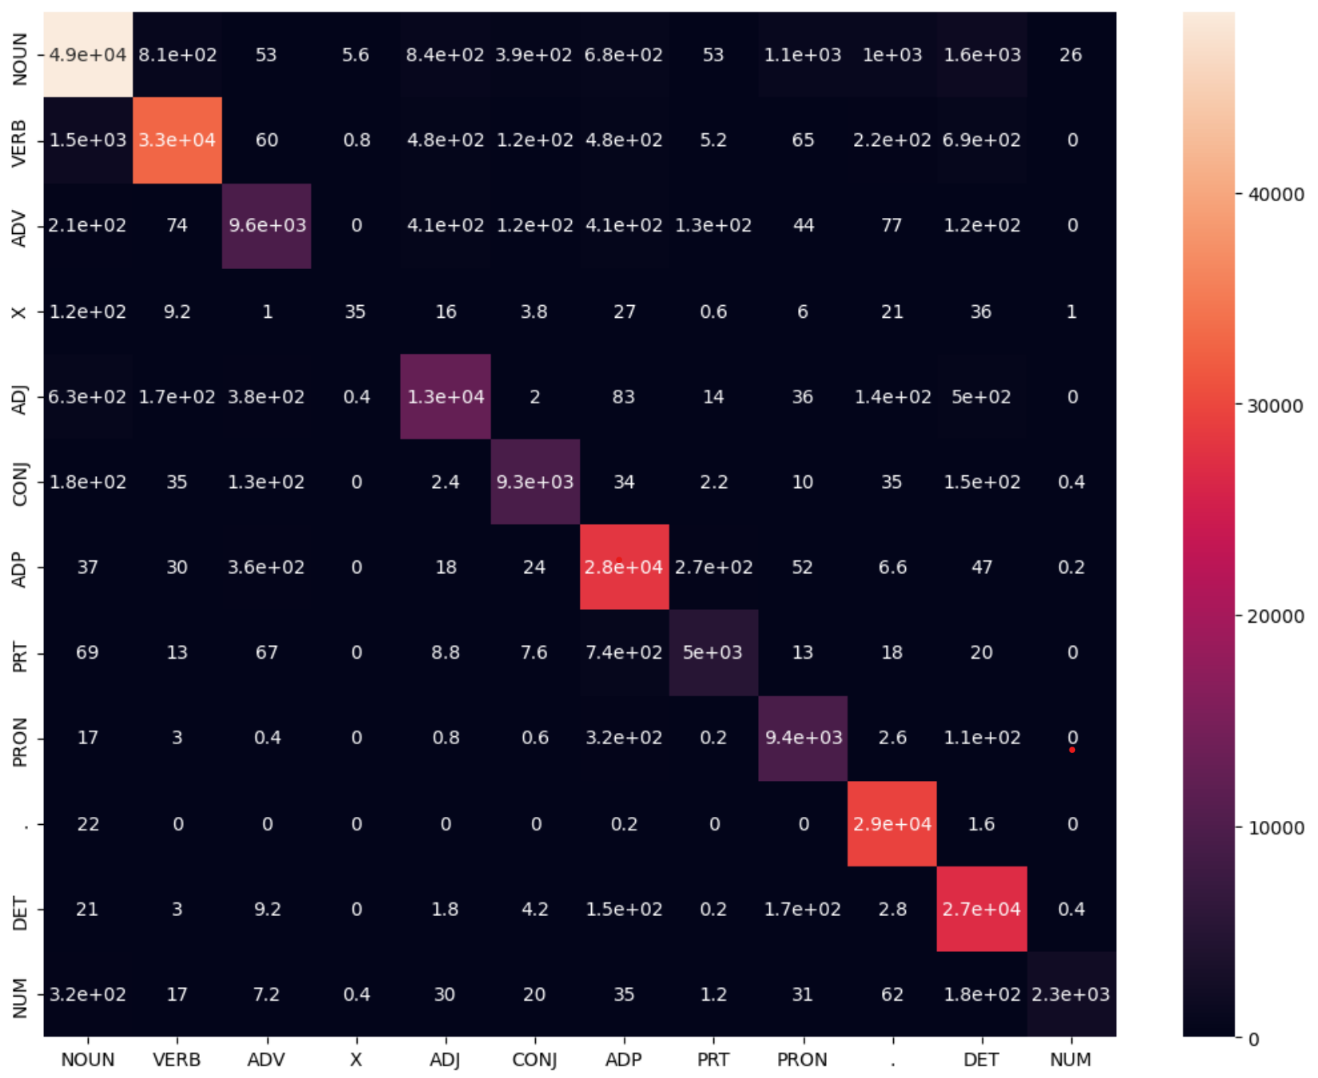
Confusion Matrix (12 X 12)

Slide 6
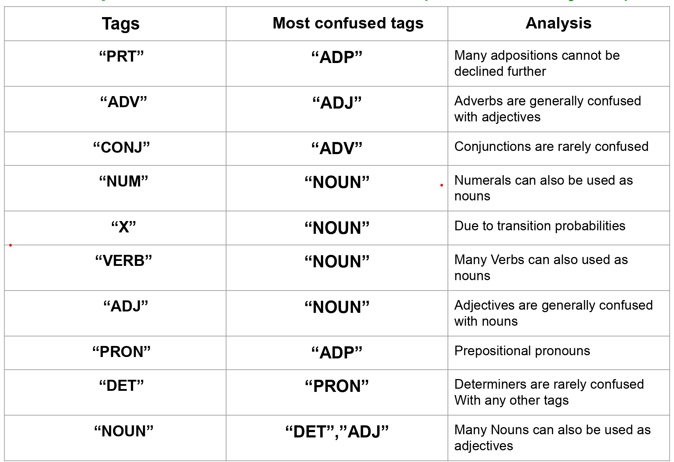
Interpretation of confusion (error analysis)

Slide 7
Data Processing Info (Pre-processing)
We have split the downloaded data into 5 batches and we have trained the model 5 times using 4 of the 5 batches at a time and used the remaining batch as test set.
We have defined a function which takes train sentences as input and returns tag set and word set.
We also defined a function which takes train sentences as input and calculates p(tag|tag),p(word|tag) values which were stored in matrices and were returned.

Slide 8
Inferencing/Decoding Info
When the number of tags in a tagset is N then at each word
We analysed N*N paths and went to the next word with choosing best N paths among them.
We have used a numpy array for forward propagation of shape (N, length(sentence)) for storing the maximum probability of tag with every word and also used another numpy array of same shape for backtracking, here for each word,tag we have stored the tag index of previous word for which the probability of current tag is maximised.
We have found out the maximum value in the last column of forward propagation matrix and then with the help of backtracking matrix we build the tag sequence of a particular sentence.

Slide 9
Demo
Streamlit GUI

Slide 10
Marking Scheme
1. Demo working- 10/10 (if not, 0)
2. Implemented Viterbi and Clarity on Viterbi- 5/5
3. Transition and Lexical tables clearly described- 5/5
4. Confusion matrix drawn and error analysed- 5/5
5. Overall F-score > 90- 10/10, >80 & <=90- 8/10, else 6/10
6. Unknown word handling- done (5/5; else 0)

Slide 11
Any thoughts on generative vs. discriminative POS tagging
In general, a discriminative model models the decision boundary between the classes, and a generative model explicitly models the actual distribution of each class.
A generative model learns the joint probability distribution 𝑝(𝑥,𝑦). It predicts the conditional probability with the help of the Bayes Theorem. A discriminative model learns the conditional probability distribution 𝑝 (𝑦|𝑥).

